Slide 1
Software Evolution, Reengineering and Reverse Engineering

Slide 2
Objectives
To explain why change is inevitable if software systems are to remain useful
To discuss software maintenance and maintenance cost factors
To describe the processes involved in software evolution
To discuss an approach to assessing evolution strategies for legacy systems

Slide 3
Software change
Software change is inevitable
  New requirements emerge when the software is used;
  The business environment changes;
  Errors must be repaired;
  New computers and equipment is added to the system;
  The performance or reliability of the system may have to be improved.
A key problem for organisations is implementing and managing change to their existing software systems.

Slide 4
Importance of evolution
Organisations have huge investments in their software systems - they are critical business assets.
To maintain the value of these assets to the business, they must be changed and updated.
The majority of the software budget in large companies is devoted to evolving existing software rather than developing new software.

Slide 5
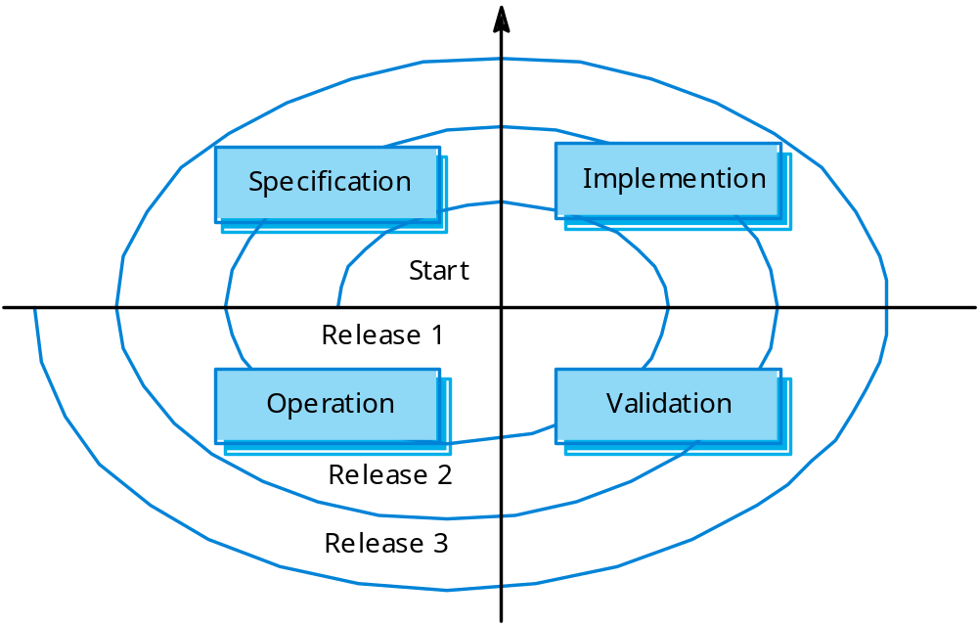
Spiral model of evolution

Slide 6
Program evolution dynamics
Program evolution dynamics is the study of the processes of system change.
After major empirical studies, Lehman and Belady proposed that there were a number of ‘laws’ which applied to all systems as they evolved.
There are sensible observations rather than laws. They are applicable to large systems developed by large organizations. Perhaps less applicable in other cases.

Slide 7
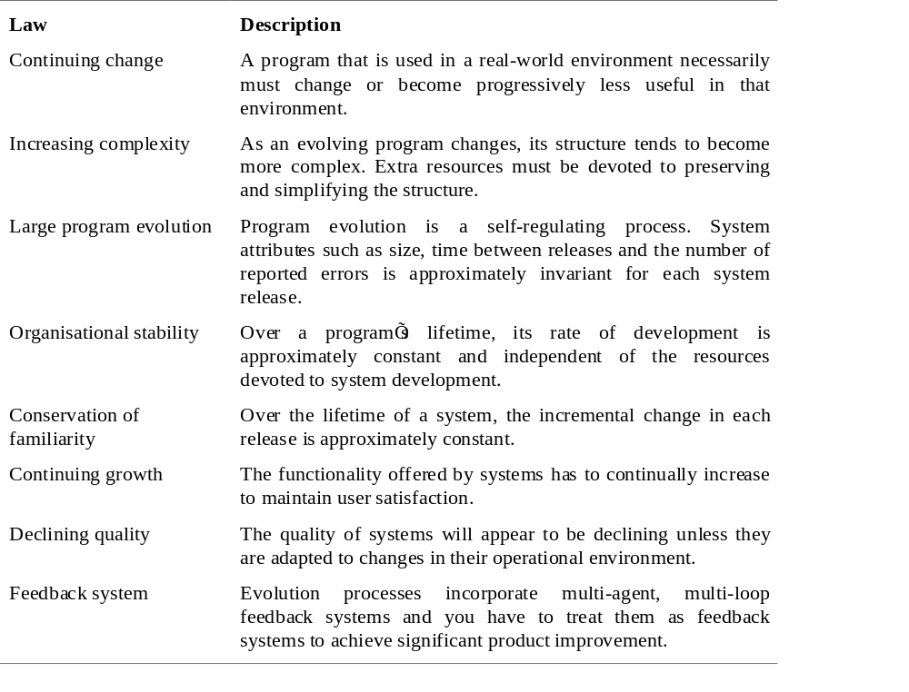
Lehman’s laws

Slide 8
Applicability of Lehman’s laws
Lehman’s laws seem to be generally applicable to large, tailored systems developed by large organisations.
  Confirmed in more recent work by Lehman on the FEAST project (see further reading on book website).
It is not clear how they should be modified for
  Shrink-wrapped software products;
  Systems that incorporate a significant number of COTS components;
  Small organisations;
  Medium sized systems.

Slide 9
Software maintenance
Modifying a program after it has been put into use.
Maintenance does not normally involve major changes to the system’s architecture.
Changes are implemented by modifying existing components and adding new components to the system.

Slide 10
Maintenance is inevitable
The system requirements are likely to change while the system is being developed because the environment is changing. Therefore a delivered system won't meet its requirements!
Systems are tightly coupled with their environment. When a system is installed in an environment it changes that environment and therefore changes the system requirements.
Systems MUST be maintained therefore if they are to remain useful in an environment.

Slide 11
Types of maintenance
Maintenance to repair software faults
  Changing a system to correct deficiencies in the way meets its requirements.
Maintenance to adapt software to a different operating environment
  Changing a system so that it operates in a different environment (computer, OS, etc.) from its initial implementation.
Maintenance to add to or modify the system’s functionality
  Modifying the system to satisfy new requirements.

Slide 12
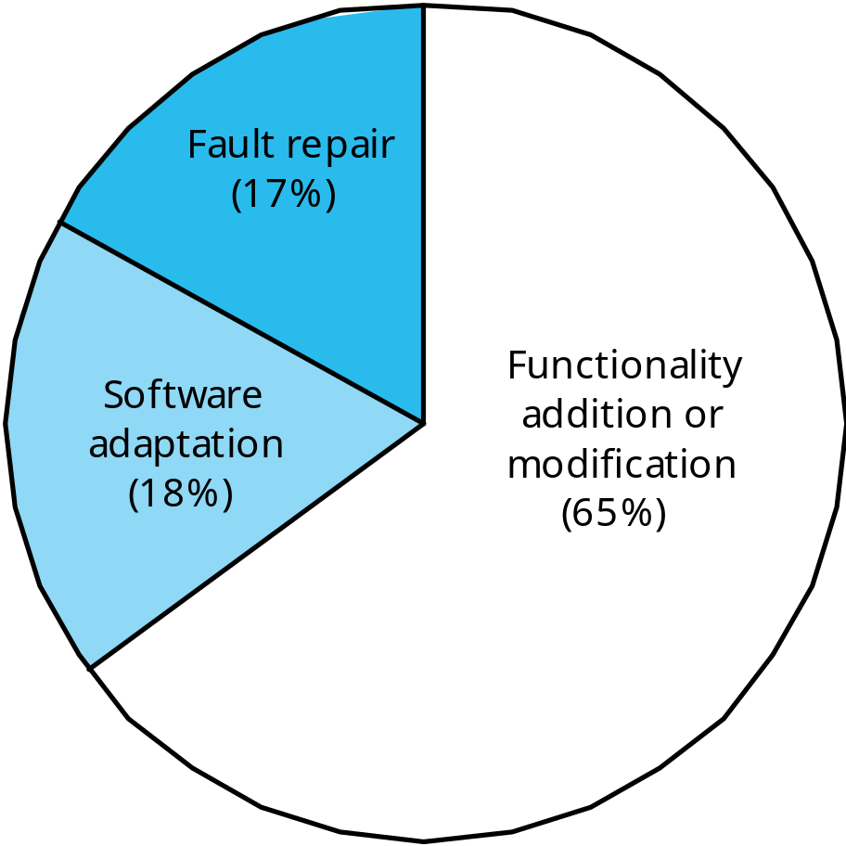
Distribution of maintenance effort

Slide 13
Maintenance costs
Usually greater than development costs (2* to 100* depending on the application).
Affected by both technical and non-technical factors.
Increases as software is maintained. Maintenance corrupts the software structure so makes further maintenance more difficult.
Ageing software can have high support costs (e.g. old languages, compilers etc.).

Slide 14
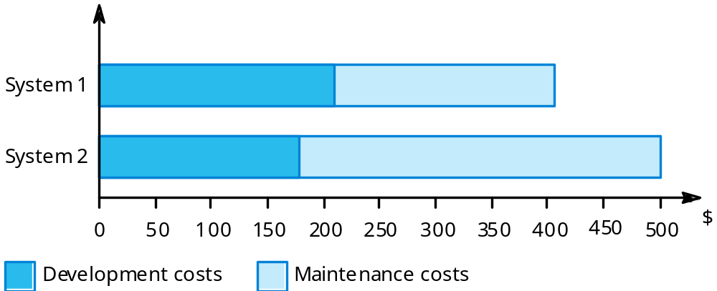
Development/maintenance costs

Slide 15
Maintenance cost factors
Team stability
  Maintenance costs are reduced if the same staff are involved with them for some time.
Contractual responsibility
  The developers of a system may have no contractual responsibility for maintenance so there is no incentive to design for future change.
Staff skills
  Maintenance staff are often inexperienced and have limited domain knowledge.
Program age and structure
  As programs age, their structure is degraded and they become harder to understand and change.

Slide 16
Maintenance prediction
Maintenance prediction is concerned with assessing which parts of the system may cause problems and have high maintenance costs
  Change acceptance depends on the maintainability of the components affected by the change;
  Implementing changes degrades the system and reduces its maintainability;
  Maintenance costs depend on the number of changes and costs of change depend on maintainability.

Slide 17
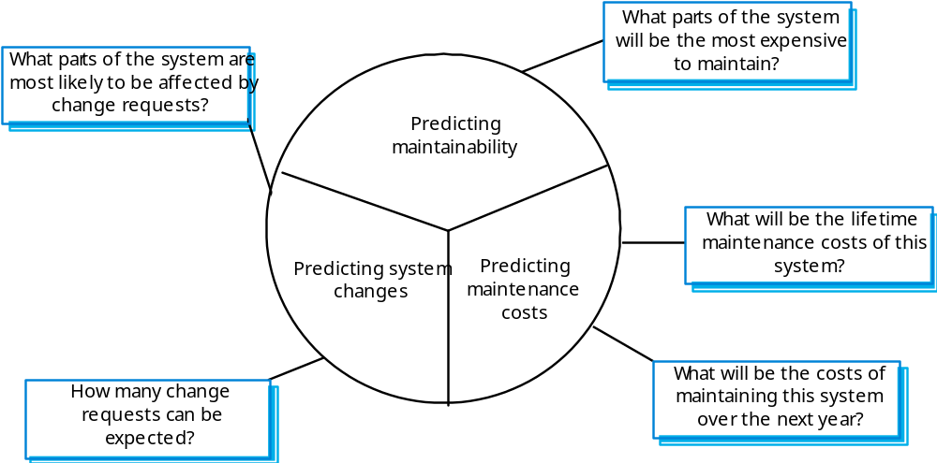
Maintenance prediction

Slide 18
Change prediction
Predicting the number of changes requires and understanding of the relationships between a system and its environment.
Tightly coupled systems require changes whenever the environment is changed.
Factors influencing this relationship are
  Number and complexity of system interfaces;
  Number of inherently volatile system requirements;
  The business processes where the system is used.

Slide 19
Complexity metrics
Predictions of maintainability can be made by assessing the complexity of system components.
Studies have shown that most maintenance effort is spent on a relatively small number of system components.
Complexity depends on
  Complexity of control structures;
  Complexity of data structures;
  Object, method (procedure) and module size.

Slide 20
Process metrics
Process measurements may be used to assess maintainability
  Number of requests for corrective maintenance;
  Average time required for impact analysis;
  Average time taken to implement a change request;
  Number of outstanding change requests.
If any or all of these is increasing, this may indicate a decline in maintainability.

Slide 21
Evolution processes
Evolution processes depend on
  The type of software being maintained;
  The development processes used;
  The skills and experience of the people involved.
Proposals for change are the driver for system evolution. Change identification and evolution continue throughout the system lifetime.

Slide 22
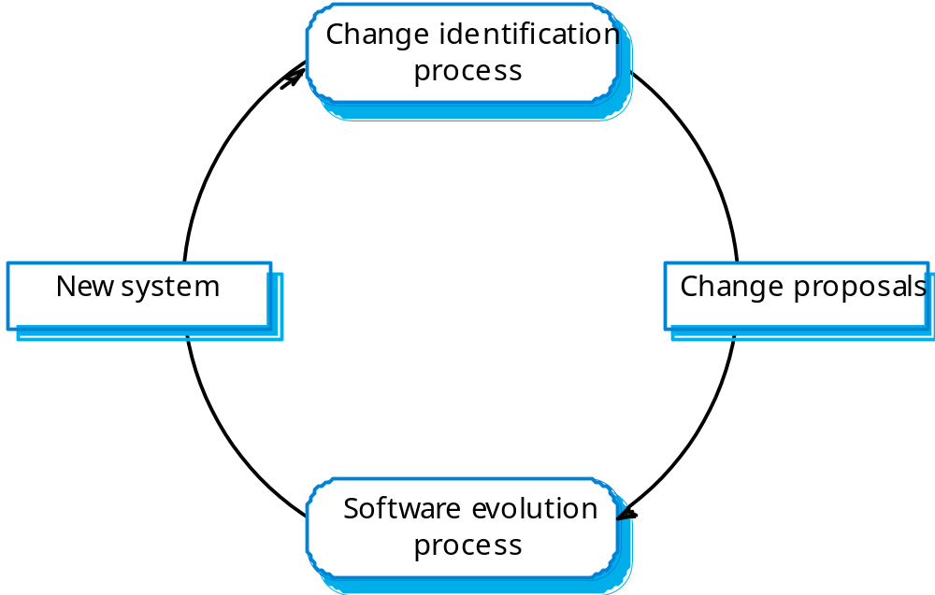
Change identification and evolution

Slide 23
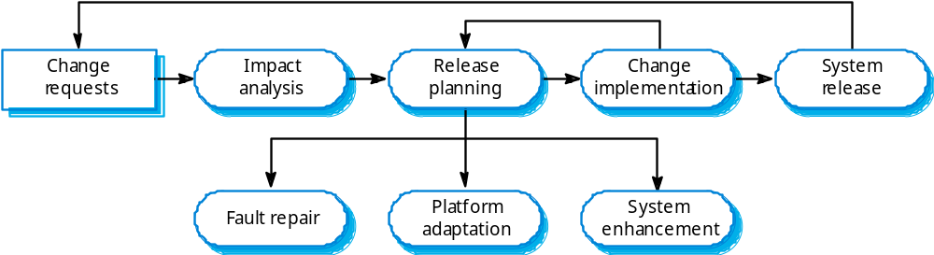
The system evolution process

Slide 24
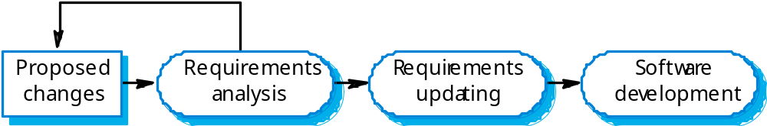
Change implementation

Slide 25
Urgent change requests
Urgent changes may have to be implemented without going through all stages of the software engineering process
  If a serious system fault has to be repaired;
  If changes to the system’s environment (e.g. an OS upgrade) have unexpected effects;
  If there are business changes that require a very rapid response (e.g. the release of a competing product).

Slide 26
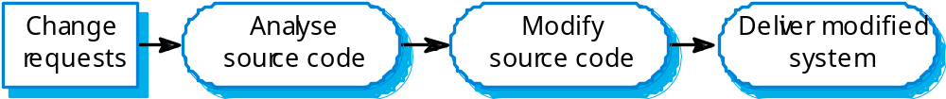
Emergency repair

Slide 27
System re-engineering
Re-structuring or re-writing part or all of a legacy system without changing its functionality.
Applicable where some but not all sub-systems of a larger system require frequent maintenance.
Re-engineering involves adding effort to make them easier to maintain. The system may be re-structured and re-documented.

Slide 28
Advantages of reengineering
Reduced risk
  There is a high risk in new software development. There may be development problems, staffing problems and specification problems.
Reduced cost
  The cost of re-engineering is often significantly less than the costs of developing new software.

Slide 29
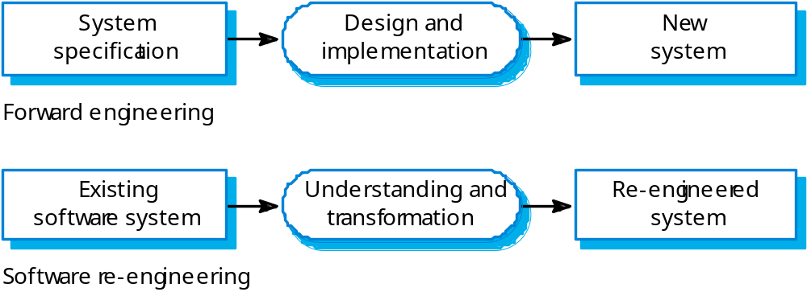
Forward and re-engineering

Slide 30
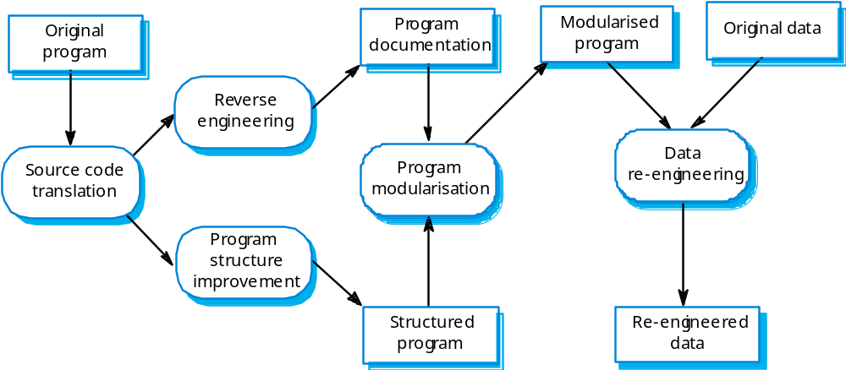
The re-engineering process

Slide 31
Reengineering process activities
Source code translation
  Convert code to a new language.
Reverse engineering
  Analyse the program to understand it;
Program structure improvement
  Restructure automatically for understandability;
Program modularisation
  Reorganise the program structure;
Data reengineering
  Clean-up and restructure system data.

Slide 32
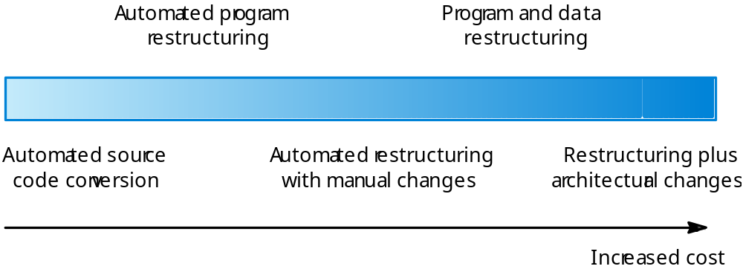
Re-engineering approaches

Slide 33
Reengineering cost factors
The quality of the software to be reengineered.
The tool support available for reengineering.
The extent of the data conversion which is required.
The availability of expert staff for reengineering.
  This can be a problem with old systems based on technology that is no longer widely used.

Slide 34
Reverse engineering
Analysing software with a view to understanding its design and specification
May be part of a re-engineering process but may also be used to re-specify a system for re-implementation
Builds a program data base and generates information from this
Program understanding tools (browsers, cross-reference generators, etc.) may be used in this process

Slide 35
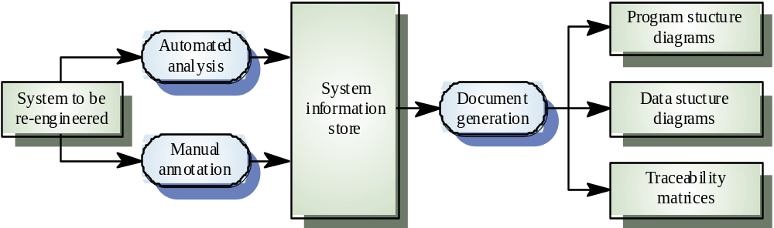
The reverse engineering process

Slide 36
Reverse engineering
Reverse engineering often precedes re-engineering but is sometimes worthwhile in its own right
  The design and specification of a system may be reverse engineered so that they can be an input to the requirements specification process for the system’s replacement
  The design and specification may be reverse engineered to support program maintenance

Slide 37
Program structure improvement
Maintenance tends to corrupt the structure of a program. It becomes harder and harder to understand
The program may be automatically restructured to remove unconditional branches
Conditions may be simplified to make them more readable

Slide 38
Legacy system evolution
Organisations that rely on legacy systems must choose a strategy for evolving these systems
  Scrap the system completely and modify business processes so that it is no longer required;
  Continue maintaining the system;
  Transform the system by re-engineering to improve its maintainability;
  Replace the system with a new system.
The strategy chosen should depend on the system quality and its business value.

Slide 39
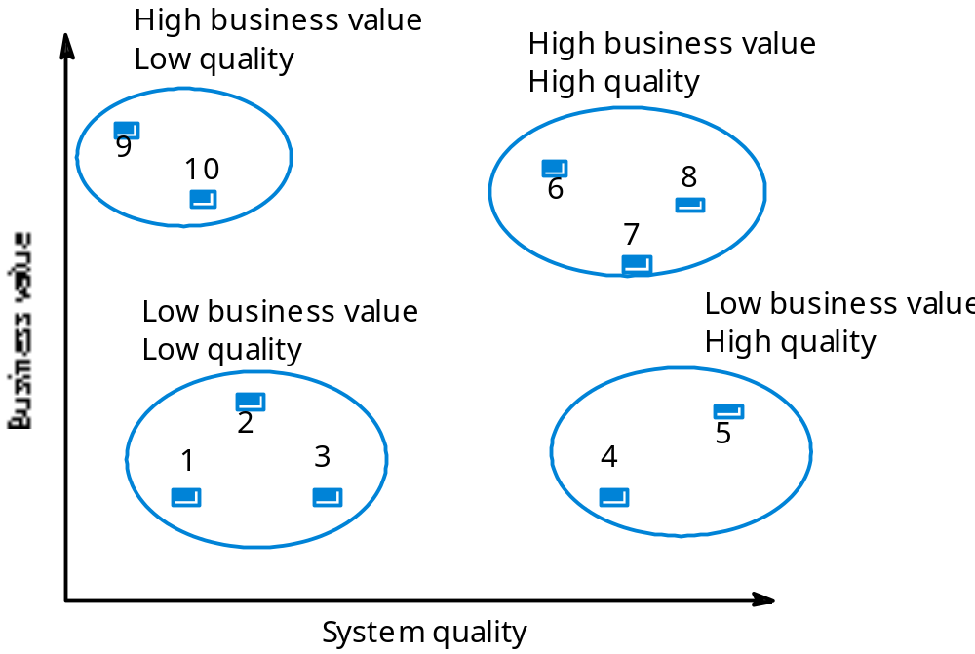
System quality and business value

Slide 40
Legacy system categories
Low quality, low business value
  These systems should be scrapped.
Low-quality, high-business value
  These make an important business contribution but are expensive to maintain. Should be re-engineered or replaced if a suitable system is available.
High-quality, low-business value
  Replace with COTS, scrap completely or maintain.
High-quality, high business value
  Continue in operation using normal system maintenance.

Slide 41
Business value assessment
Assessment should take different viewpoints into account
  System end-users;
  Business customers;
  Line managers;
  IT managers;
  Senior managers.
Interview different stakeholders and collate results.

Slide 42
System quality assessment
Business process assessment
  How well does the business process support the current goals of the business?
Environment assessment
  How effective is the system’s environment and how expensive is it to maintain?
Application assessment
  What is the quality of the application software system?

Slide 43
Business process assessment
Use a viewpoint-oriented approach and seek answers from system stakeholders
  Is there a defined process model and is it followed?
  Do different parts of the organisation use different processes for the same function?
  How has the process been adapted?
  What are the relationships with other business processes and are these necessary?
  Is the process effectively supported by the legacy application software?
Example - a travel ordering system may have a low business value because of the widespread use of web-based ordering.

Slide 44
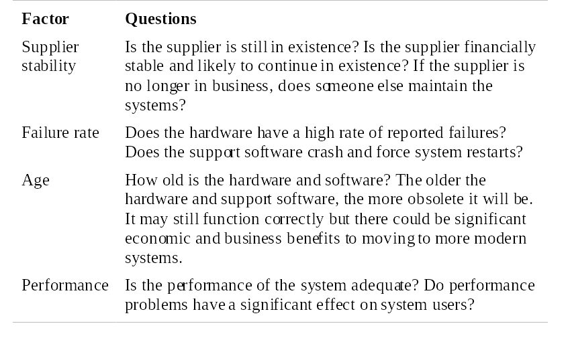
Environment assessment 1

Slide 45
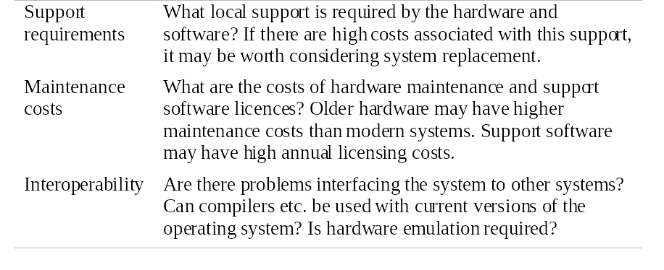
Environment assessment 2

Slide 46
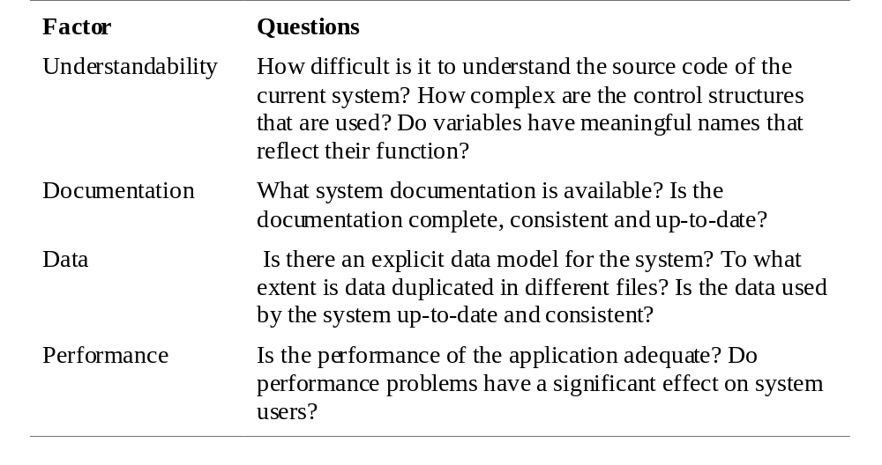
Application assessment 1

Slide 47
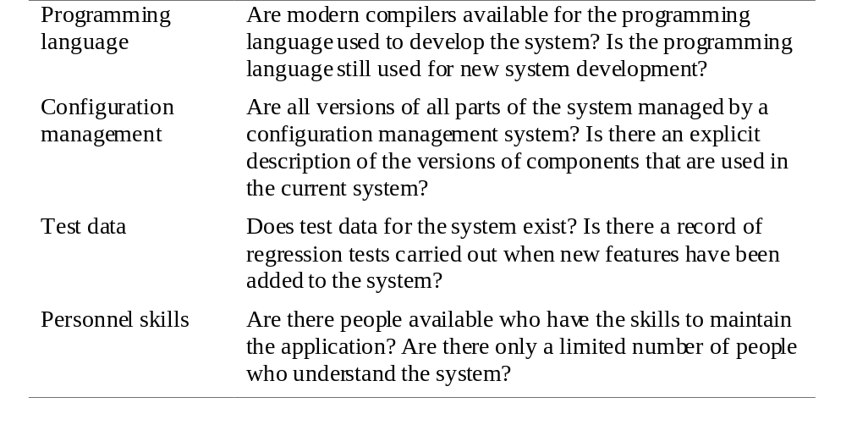
Application assessment 2

Slide 48
System measurement
You may collect quantitative data to make an assessment of the quality of the application system
  The number of system change requests;
  The number of different user interfaces used by the system;
  The volume of data used by the system.

Slide 49
Key points
Software development and evolution should be a single iterative process.
Lehman’s Laws describe a number of insights into system evolution.
Three types of maintenance are bug fixing, modifying software for a new environment and implementing new requirements.
For custom systems, maintenance costs usually exceed development costs.

Slide 50
Key points
The process of evolution is driven by requests for changes from system stakeholders.
Software re-engineering is concerned with re-structuring and re-documenting software to make it easier to change.
The business value of a legacy system and its quality should determine the evolution strategy that is used.

